Slide 1
Typing
CS 1622
Jarrett Billingsley

Slide 2
Class Announcements
I may hold some Extra Office Hours on Friday… what time would be best for those of you who think you may need them?

Slide 3
A little Type Theory
Notes:
- little a type theory, as a treat.

Slide 4
Remember what a type is?
a type is:
  a set of valid values, plus:
  a set of valid operations on those values
think about ints:
  there's a range of valid values of an int variable
  and a set of operators and other things you can use on them
type theory is a branch of mathematics
  it might seem kind of abstract and confusing (as most math does)
  but it has had profound impacts on the design and behaviors of programming languages, especially in the past 30 years
without rigorous type theory, you get C 😬
Notes:
- there were languages with advanced type-theoretical constructs built into them long before 30 years ago
- but they were academic languages with little or no real-world use
- type theory started to become an important part of mainstream language design starting around the early 90s
- do you want C?? cause this is how you get C!!!

Slide 5
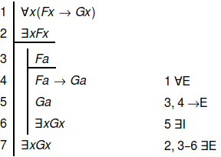
I'll Curry YOUR Howards, isomorphically
remember from the beginning of the term: programs are proofs.
type systems are essentially proof justifications.
these justifications are saying, "look, I'm using only valid operations on these values!"
similarly, when you say "this variable is an int," the compiler uses that information to justify the steps of your program.
if it can't… that's a type error!
Notes:
[diagram: just a simple first-order logic proof, with premises and steps and conclusions, and on each step there is a justification saying which other steps it depends on. those justifications are the proof-theoretic equivalent of type checking.]

Slide 6
Type Safety = Progress + Preservation
type safety means that you know exactly what will happen at every step of your program, because you know the types of everything.
progress means that at every step of computation:
…or there is exactly one thing that can happen.
either the program halts…
int[] a = { 1, 2, 3 };
a[4] = 10; // halts
int[] a = { 1, 2, 3 };
a[0] = 10; // assigns
preservation means that you know the type of every value, at every step of computation. (you never "leave the walls" of the type system.)
Java is a type-safe language, so I can't give an example of that.
but what about the most popular language used for programming our operating systems, device drivers, embedded device firmware etc.? 🙃

Slide 7
A very unsafe language
in C, the type system was an afterthought.
float f = 3.4;
int a[10];
a[10] = 0xDEADBEEF;
printf("%f\n", f);
this line of code violates both progress and preservation.
it violates progress because accessing an array out-of-bounds is "undefined behavior" (UB), which means "anything could happen."
it violates preservation because one of the things that could happen is that this line overwrites the value in f, violating its type.
depending on the platform and compilation settings, this printf might show 3.4 or -6259853398707798016.000000!
Notes:
- the C spec is littered with UB, and every single piece of UB means "the implementation can choose whatever the hell it wants to do."
- it COULD give an "array index out of bounds" error at runtime! that conforms to the spec!
- but there are no guarantees, so there are an infinite number of possible "next steps."
- a violation of preservation is also related to the idea of "soundness" – the idea that the type of a value never changes.
- there are other ways to violate preservation, but this is the most basic and egregious way.

Slide 8
Safety has to be built-in
once you step into UB, you cannot guarantee anything.
  it's like writing a proof with an incorrect step.
  all the steps after may or may not be invalid!
  HLLs are a set of abstractions, and type-unsafety lets you ruin those abstractions entirely.
you can't make C safe. this has big consequences:
  you can't do automatic memory management, because that requires you to know the types of every value in the program.
  you can't prove that a C program is correct, because there are many "correct" programs which actually violate type safety.
you can't be superhuman. sorry, but no amount of "just write the code correctly" is going to lead to correct C code. mistakes happen.
  this is why languages like Java and Rust exist!

Slide 9
Decidability
decidable means: "can this question be answered in finite time?"
type-checking is an algorithm, so it can be undecidable.
  we can make our type system so powerful that we'd have to solve the halting problem to check our program's types!
    which maybe seems like a bad thing, right?
there's this other related thing that I think is related to decidability?
  you can't predict the future.
  that means sometimes you can't know what type something is until runtime, no matter how clever your type system is.
so if you want programmers to have that (very useful!) ability, you have to design your type system to allow for it in a safe way.
  we'll see some examples shortly.

Slide 10
Type systems

Slide 11
The primitive types
a language's problem domain is the problems it's designed to solve.
  most languages try to be "general purpose" and therefore give you relatively few, simple primitive types, like int, char, bool, etc.
the hardware also dictates what primitives are available.
  e.g. on GPUs, 4-element vectors and 4x4 matrices are primitives!
domain-specific languages (DSLs) are designed to do one job well.
  these might have many primitive types, including types which don't seem very "primitive" at all.
  for example, a shell scripting language may have primitive types like files, processes, and terminal emulators.
the set of primitive types is really a product of what problems you want your language to be able to solve easily.

Slide 12
Static vs. Dynamic typing
remember: static ="before runtime;" dynamic = "at runtime."
statically typed languages associate types with variables.
dynamically typed languages associate types with values.
let mut a = 10;
a = 20; // ok
a = "hello"; // bad
a = a / 2; // ok
let a = 10; // JS
a = 20; // ok
a = "hello"; // ok!
a = a / 2; // bad
in dynamically typed languages, type errors cannot be found until you run the program.
but this is a spectrum: many statically-typed languages include dynamically-typed features too!

Slide 13
Dynamic types in static languages
sometimes it's useful not to know the type until runtime.
class A { String toString() { return "A"; } }
class B { String toString() { return "B"; } }
Object o;
if(user types A)
o = new A();
else
o = new B();
o.toString();
this works because of Java's subtyping rules and virtual methods.
calling toString() is a valid operation on any Object, and every class instance is an Object.
this is a form of existential polymorphism: we don't know what type it is until runtime, but we at least know that it will support this operation!
Notes:
- Java's interfaces and bounded generics are two other kinds of existential polymorphism.
- both let you use many different types in one place, but both also impose some set of operations that they must support.
- "existential" as in the backwards capital E thing, yes
- next class…

Slide 14
Type coercion ("punning") and conversion
type coercion is when the language will let you use the "wrong" type and it will automatically turn it into the "right" one.
type conversion creates a new value of a different type.
  some type coercions do a type conversion; some don't!
// Java
int x = 10;
float f = x;
// now f == 10.0
int x = 10;
String s = "x = " + x;
// now s is "x = 10"
implicit conversions like these can make code shorter and more readable…
but they can be confusing too:
// JavaScript
let x = 10 + "20";
let y = 10 – "20";
// x == "1020"
// y == -10 ?!

Slide 15
Strong vs. Weak typing
different people use “strong” and “weak” to mean different things.
one definition is basically the same as type safety: it says that weakly-typed languages let you “step around” the type system, while strongly-typed languages keep you in.
another definition is that weakly-typed languages do lots of implicit conversions and almost never give type errors, instead choosing to “do something else.”
// JavaScript again
alert([] + []); // ""
alert({} + {}); // NaN
alert({} + []); // 0
alert([] + {}); // {}
// C
bool b = true;
int* p = (int*)&b;
*p = 700; // wat.
I like to think ”weakly-typed” means “the language doesn’t care about types, for some value of ‘doesn’t care’” lol
Notes:
the C code on the left is “stepping around” the type of b as a bool, and putting 700 in it. Which is bad and will Cause Issues.
cause the abstraction given to you by bool says there are two values, true and false, and what is 700? it’s neither of those.
so all the code that relies on b containing true or false might now behave very strangely.
the JavaScript code on the right is showing just how strange the “plus” operator is.
empty square brackets create an array object; empty curly braces create a “class-like” object
what does it mean to “add” two arrays? apparently it means “turn them both to strings and then concatenate the results”
but if an object is involved, it turns the operands to numbers? or something? it’s really confusing

Slide 16
The typing alignment chart
if we treat strong/weak and static/dynamic as axes on a spectrum…
strong
Python
Rust
Fortran
Java
TypeScript
dynamic
C++
static
JS
PHP
C
weak
Notes:
- you could probably do a good/evil-lawful/chaotic one too. I mean clearly C is chaotic evil…
- strong/static is the most rigid, which catches a lot of bugs, but that rigidity can be taken to an irritating extreme, making certain programming styles very awkward and unnatural
- weak/dynamic is the most flexible, but it can feel a bit like programming on shifting sand, since there's not much keeping you from messing up
- strong/dynamic is also flexible, but leaves you kind of feeling "why isn't this statically typed?"
weak/static is kind of the worst of both worlds? like why even bother with types at that point lol
[diagram: a two-dimensional space where the axes are static-dynamic and strong-weak, and some widely-used languages are placed in this space. Fortran is very strong and totally static. Python is strong, but totally dynamic. PHP is weak and dynamic. C is weak and static. C++ is kind of smack in the middle. Java is somewhat strong, but in the middle of static and dynamic. Rust is very strong, more static than dynamic, but has enough dynamic features to put it sort of close to Java. JavaScript is pretty weak and totally dynamic. TypeScript is more dynamic than static, and on the strong side, but it’s in kind of an interesting position that not many other languages are.]

Slide 17
Type inference
type inference automatically determines what type something is.
you may not know it, but you've been using it for years.
int x = 10;
int y = x + 5;
the compiler implicitly determines the types of the parts of the expressions, and which addition operation to do.
imagine having to write this…
int x = 10:int;
int y = x:int +:int 5:int;
type inference can go further, too, like variables in Rust!
let x = 10; // x: i32
let y = Some(x); // y: Option<i32>
Notes:
- remember, integer addition and float addition are totally different operations!
- and Java also uses + for string concatenation, so the compiler has to check for that too.
- Rust has a rule that unsuffixed integers, with no other constraints on them, will become i32. https://doc.rust-lang.org/stable/rust-by-example/types/literals.html

Slide 18
Defining Type Systems

Slide 19
Terms and types
a term is a thing that has a value.
  it's either a value itself, or it can be evaluated to get one.
    (that sounds a lot like an expression…)
every value has a type, and therefore every term has a type.
PL theory writes this relation like so:
term:Type
like:
x:i32
and now you know why Rust uses this syntax.
Notes:
- TypeScript, JS, Python, Haskell, OCaml, and many, many other languages also use this syntax.
- it's really just C and some of its descendants – LIKE JAVA – that do the "type-before-the-name" thing.

Slide 20
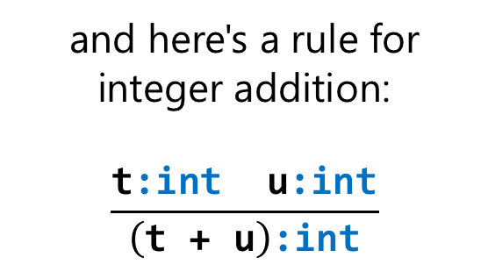
Inference rules
a type system's inference rules explain how to give a type to a term.
some rules are axiomatic: they are the "ground truth" of the types.
others say how to determine the type of a more complex term.
here's an axiomatic rule that says all integer literals are of type int:
<IntExp>:int
and here's a rule for integer addition:
$$\frac{\text{t}\text{:}\text{int} \text{u}\text{:}\text{int}}{\left(\text{t}\text{ + }\text{u}\right)\text{:}\text{int}}$$
(where IntExp is the kind of AST node that represents integer literals.)
"if t is an int and u is an int, then (t+u) is an int."
our type checking algorithm will be driven by these rules.
if no rule can be applied, it's a type error!
Notes:
- it looks a bit funny, but it's just an implication. or a really vertically-compressed proof.
- t:int ∧ u:int → (t + u):int
[diagram: the way typing rules are usually written is as a short proof where the premises are listed above a bar and the conclusion is below it. the typing rule here has “t:int u:int” above the bar, and “(t + u):int” below the bar. so, it means “if t is an int and u is an int, then the result of adding t and u is an int.”]

Slide 21
The type context
in addition to the axiomatic rules, we also need some context to assign types to some terms, like variables.
int x = 10;
int y = x + 5;
how do we know what type x is?
we have to look back to its declaration.
fortunately, name resolution has already determined which symbol x refers to!
the type context is another mapping: it associates symbols in the symbol table with types.
here, int x explicitly associates x with the type int…
but in languages with type inference, the type of the initializer would have to be determined first.
Notes:
- in Truss, all variable declarations are required to have initializers so the inference is very simple.
- in Rust, you can skip the initializer and assign it in multiple places, requiring much more sophisticated algorithms to figure out exactly what type the variable should be.
- but in return, you get a much more expressive language that doesn't require as much typing. like, "typing on the keyboard" typing. lol.

Slide 22
Truss's type system
let's examine the type system of this toy language to get familiar with how these concepts play out.
first, it has a set of four primitive types.
  int: a signed 32-bit integer
  bool: a truth value, true or false
  string: an immutable sequence of 0 or more codepoints
  (): the absence of a type, called void
    this is only used for function return types.
it might not look like it, but we've sort of implicitly defined the sets of valid values for each type.
  there are 2³² valid values for int…
  2 valid values for bool…
  and so on.
Notes:
- and a technically-finite-but-practically-infinite number of possible values for strings!
- and 0 valid values for () - it is an empty type.

Slide 23
Function Types
any language that has functions will also need a type for them.
or to be more accurate, a type constructor for them.
Truss writes its function types like: fn(A₀, A₁, …): R,
where A₀, A₁ etc. are the arguments and R is the return type.
functions can have any number of arguments, which is why the argument types are written like that.
here are some valid function types:
fn(): ()
fn(int): int
fn(string, string): bool
fn(fn():()): ()
the last one is a higher order function: it takes a function as an argument!
Truss also has structs, but we'll come back for those later…
Notes:
- some languages – like Java – have a concept of a function type within the compiler but it is not possible to express them in the language.
- if your language doesn't have higher-order functions, you don't really need to be able to write them.
- but higher-order functions are stupidly useful so I put them in Truss so THERE.

Slide 24
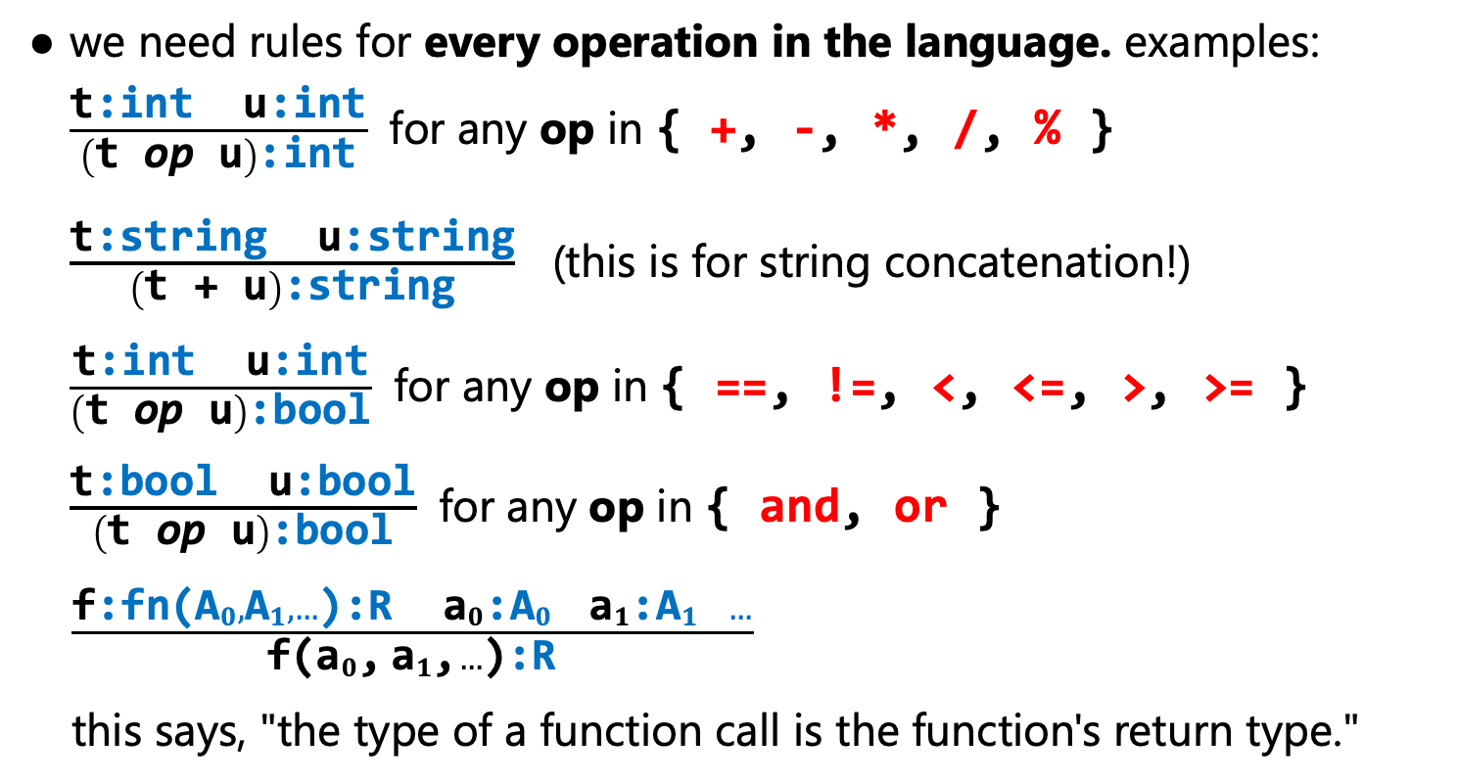
Inference rules
we need rules for every operation in the language. examples:
  $\frac{\text{t}\text{:}\text{int} \text{u}\text{:}\text{int}}{\left(\text{t} \text{op} \text{u}\right)\text{:}\text{int}}$ for any op in { +, -, *, /, % }
  $\frac{\text{t}\text{:}\text{string} \text{u}\text{:}\text{string}}{\left(\text{t}\text{ + }\text{u}\right)\text{:}\text{string}}$ (this is for string concatenation!)
  $\frac{\text{t}\text{:}\text{int} \text{u}\text{:}\text{int}}{\left(\text{t} \text{op} \text{u}\right)\text{:}\text{bool}}$ for any op in { ==, !=, <, <=, >, >= }
  $\frac{\text{t}\text{:}\text{bool} \text{u}\text{:}\text{bool}}{\left(\text{t} \text{op} \text{u}\right)\text{:}\text{bool}}$ for any op in { and, or }
  $\frac{\text{f}\text{:}\text{fn}\text{(}{\text{A}}_{0},{\text{A}}_{1},…\text{):}\text{R} {\text{a}}_{0}\text{:}{\text{A}}_{0} { \text{a}}_{1}\text{:}{\text{A}}_{1} …}{\text{f}\text{(}{\text{a}}_{0}\text{,}{ \text{a}}_{1}\text{,}…\text{)}\text{:}\text{R}}$
  this says, "the type of a function call is the function's return type."
Notes:
[rules: rule 1 says “t:int and u:int implies (t op u):int, for any of the ops +, -, *, /, and %.” rule 2 says “t:string and u:string implies (t + u):string.” that’s for string concatenation. rule 3 says “t:int and u:int implies (t op u):bool, for any of the ops ==, !=, <, <=, >, and >=.” rule 4 says “t:bool and u:bool implies (t op u):bool, for any of the ops ‘and’ and ‘or’” (these are the Truss equivalents of && and ||). finally, rule 5 says “if f is a function type with argument types A0, A1, etc. and it returns type R, and you pass it values with those argument types, then the function call itself has type R.”]

Slide 25
What about statements?
statements have gotten left out of the discussion, because they don't evaluate to a value, and therefore have no type.
but statements can interact with the type system nonetheless.
what type does the condition have to be, in Java?
if(x < 10)
println("yep");
boolean.
similar things apply for loops, switches (and Rust matches), return statements, and so on.
(we could also say that statements have a type like () or void, but it isn't strictly necessary to do this.)

Slide 26
Implementation Details

Slide 27
Data structures needed
we'll need to represent types in the compiler.
  this can be as simple as a Rust enum, very similar to how we represent the kinds of AST nodes.
we'll also need the type context like we said before.
  we said we needed this to map from symbols to types…
  but we're going to extend this to all AST nodes that can have types, because subsequent compiler passes will need this info.
  this will get filled in as we do type checking.
finally, we need a way to represent the terms…
  wait, don't we have that already?

Slide 28
OH, right, the AST!
the AST encodes terms as trees.
this implies a relatively straightforward way to check for types:
1. do a depth-first traversal to typecheck the leaves, using the axiomatic rules and type context;
CallExp
callee | args[]
f(y+2)
:()
IdentExp
name | "f"
AddExp
lhs | rhs
y+2
:int
2. typecheck the internal nodes according to the types of their children, using the inference rules.
f:fn(int):()
IdentExp
name | "y"
IntExp
value | 2
y:int
2:int
Notes:
[diagram: the AST for “f(y+2)” again. the leaves are “f”, “y”, and “2”. “2” is given type int according to the axiomatic rule that says integer literals have type int. “y” is given type int because the type context says it was declared as int. similarly “f” is given type “function that takes an int and returns void” for the same reason. “y + 2” is given type int because of the rule that says if you add ints, you get an int. and finally, “f(y+2)” is given type void, because the function takes an int and returns void.]

Slide 29
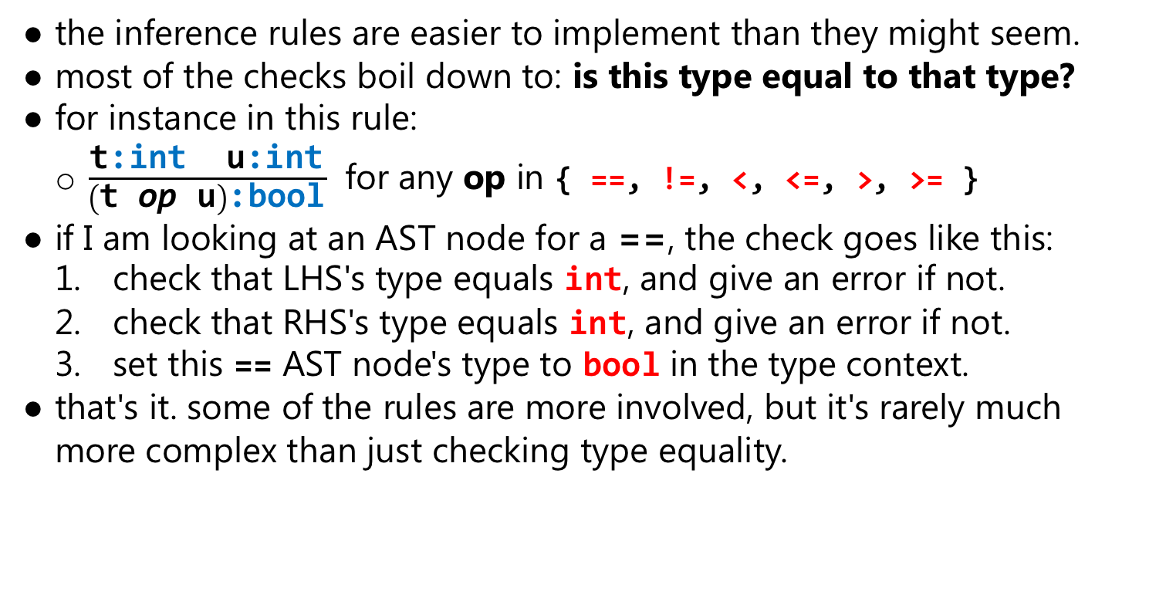
Implementing the inference rules
the inference rules are easier to implement than they might seem.
most of the checks boil down to: is this type equal to that type?
for instance in this rule:
  $\frac{\text{t}\text{:}\text{int} \text{u}\text{:}\text{int}}{\left(\text{t} \text{op} \text{u}\right)\text{:}\text{bool}}$ for any op in { ==, !=, <, <=, >, >= }
if I am looking at an AST node for a ==, the check goes like this:
  check that LHS's type equals int, and give an error if not.
  check that RHS's type equals int, and give an error if not.
  set this == AST node's type to bool in the type context.
that's it. some of the rules are more involved, but it's rarely much more complex than just checking type equality.
Notes:
[the rule: “t:int and u:int implies (t op u):bool, for any of the ops ==, !=, <, <=, >, and >=.”]

